Slide 1
What is SDLC :
SDLC or the Software Development Life Cycle is a process that produces software with the highest quality and lowest cost in the shortest time possible. SDLC provides a well-structured flow of phases that help an organization to quickly produce high-quality software which is well-tested and ready for production use.
Types
Waterfall model
Iterative model
Spiral model
V-model

Slide 2
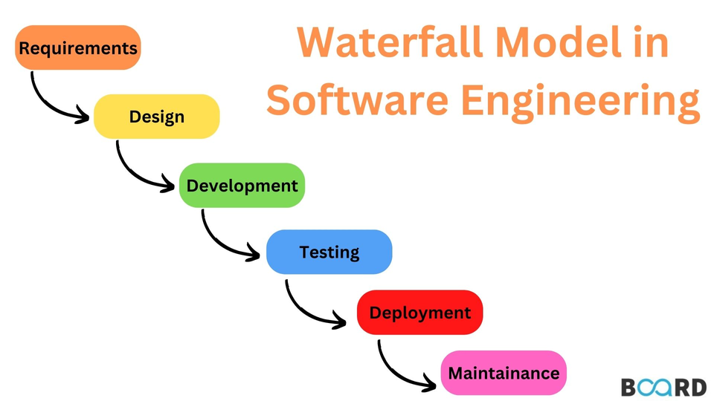
Waterfall model:
The classical waterfall model is the basic software development life cycle model. It is very simple However, it is very important because all the other software development life cycle models are based on the classical waterfall model.
Drawbacks:
Lengthy Development Cycle
Limited Flexibility
Difficult to accommodate Change Requests

Slide 3
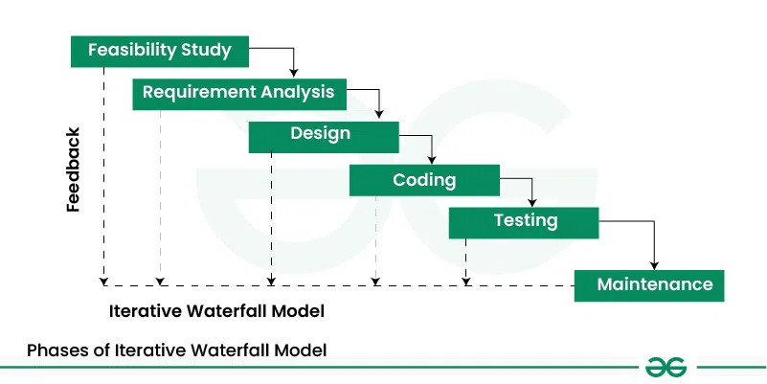
Iterative model
The Iterative Waterfall Model is a approach that combines the sequential steps of the traditional Waterfall Model . It allows for improvements and changes to be made at each stage of the development process, instead of waiting until the end of the project.
drawbacks:
Limited customer interactions
Risk handling not supported
Overlapping of phases not supported

Slide 4
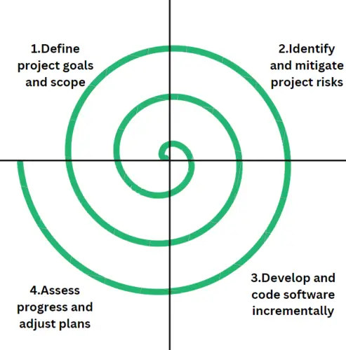
Spiral model
The Spiral Model is a combination of the waterfall model and the iterative model. It provides support for Risk Handling.
drawbacks:
Complexity:
Time-Consuming
Resource Intensive

Slide 5
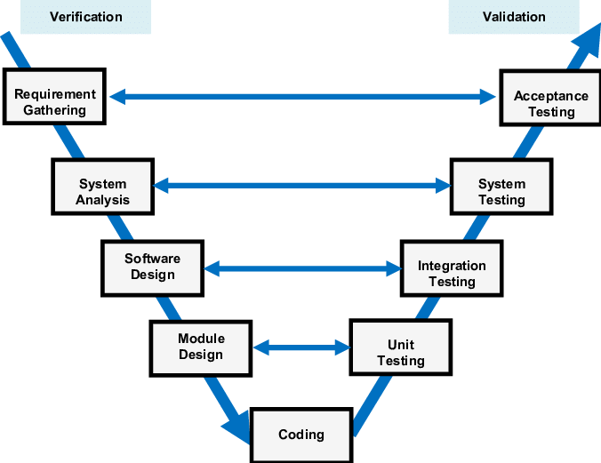
V- Model
The V-Model is a software development life cycle (SDLC) model that provides a systematic and visual representation of the software development process. It is based on the idea of a “V” shape, with the two legs of the “V” representing the progression of the software development process from requirements gathering and analysis to design, implementation, testing, and maintenance.
drawbacks:
High risk and uncertainty.
It is not good for complex and object-oriented projects.

Slide 6
Which is best model?
The selection of the best SDLC model is a strategic decision that requires a thorough understanding of the project’s requirements, constraints, and goals. Ultimately, the best SDLC model is the one that best fits the unique needs and context of the project at hand.

Slide 7
Agile values and Principles

Slide 8
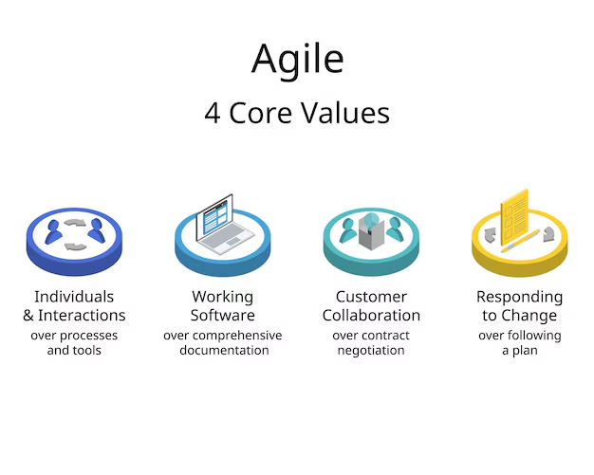
1.Having the right group of individuals on your software team is vital to success
2.The Agile Manifesto places shipping software to your customers as one of the highest priorities
3.build a feedback loop with your customers
4.teams must adapt quickly in order to deliver a quality product and ensure 100% customer satisfaction.

Slide 9
